Slide 1
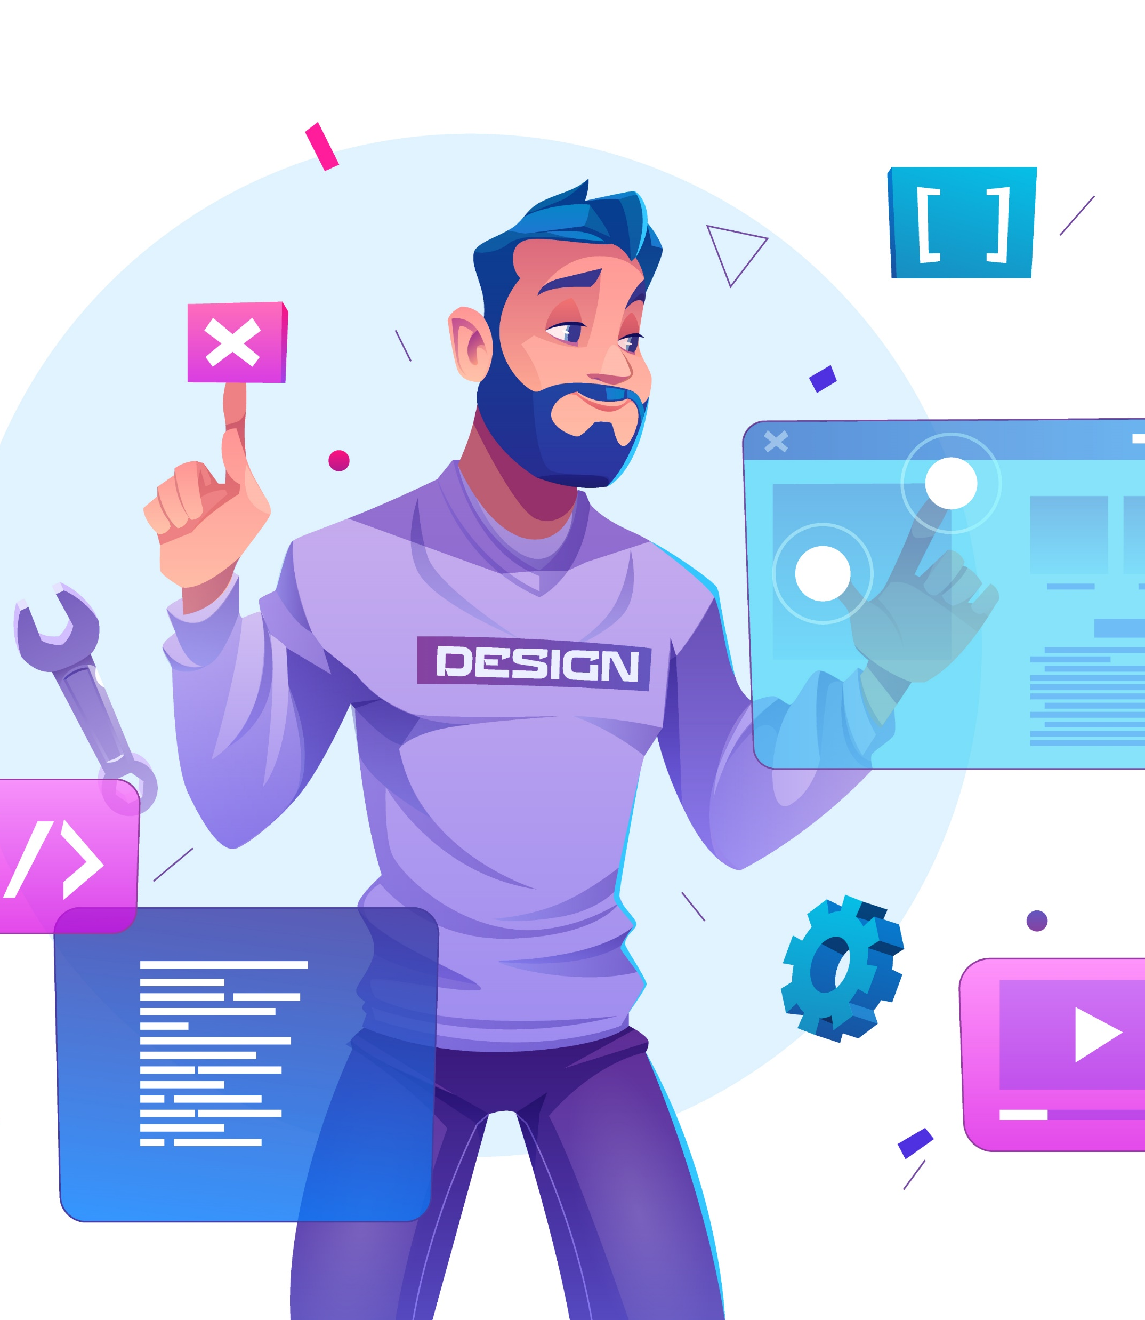
WEB
How does the web work?
The Wikipedia answer to this question is simply; The browser sends an HTTP request message to the server, asking it to send a copy of the website to the client.
This message, and all other data sent between the client and the server, is sent across your internet connection using TCP/IP.
Next Slides

Slide 2




1
How the web Works
Detailed
1
2
3
4
Step 1: URL get Resolved
Step 2: Request is Sent
Step 3: Response is Parsed
Step 4: Page is Displayed
The website code is obviously not stored on your machine and hence needs to be fetched from another computer where it is stored.
With the IP address resolved, the browser goes ahead and makes a request to the server with that IP address.
The browser receives the response sent by the server. This alone, doesn't display anything on the screen.
As mentioned, the browser goes through the HTML data returned by the server and builds a website.

Slide 3
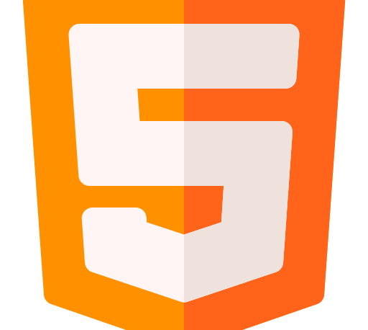


What do you need to become a web developer?
01.
02.
03.
HTML
CSS
JAVASCRIPT
Hypertext Markup Language
Html builds out the structure of your page.
Also known as the Cascading Style Sheet. CSS is used to style your web page and add more visual prowess.
JavaScript is used to build the logic that’s run in your website.

Slide 4


2
What do you need to be a web Developer
Community
Problem solving
A developer community is essential to your journey as a developer.
No matter the discipline, developers are called upon to solve user problems.
Text Editor
Portfolio
As a programmer, you need a reliable text editor to run programs on.
You need a portfolio to display your projects to showcase your skills.

Slide 5
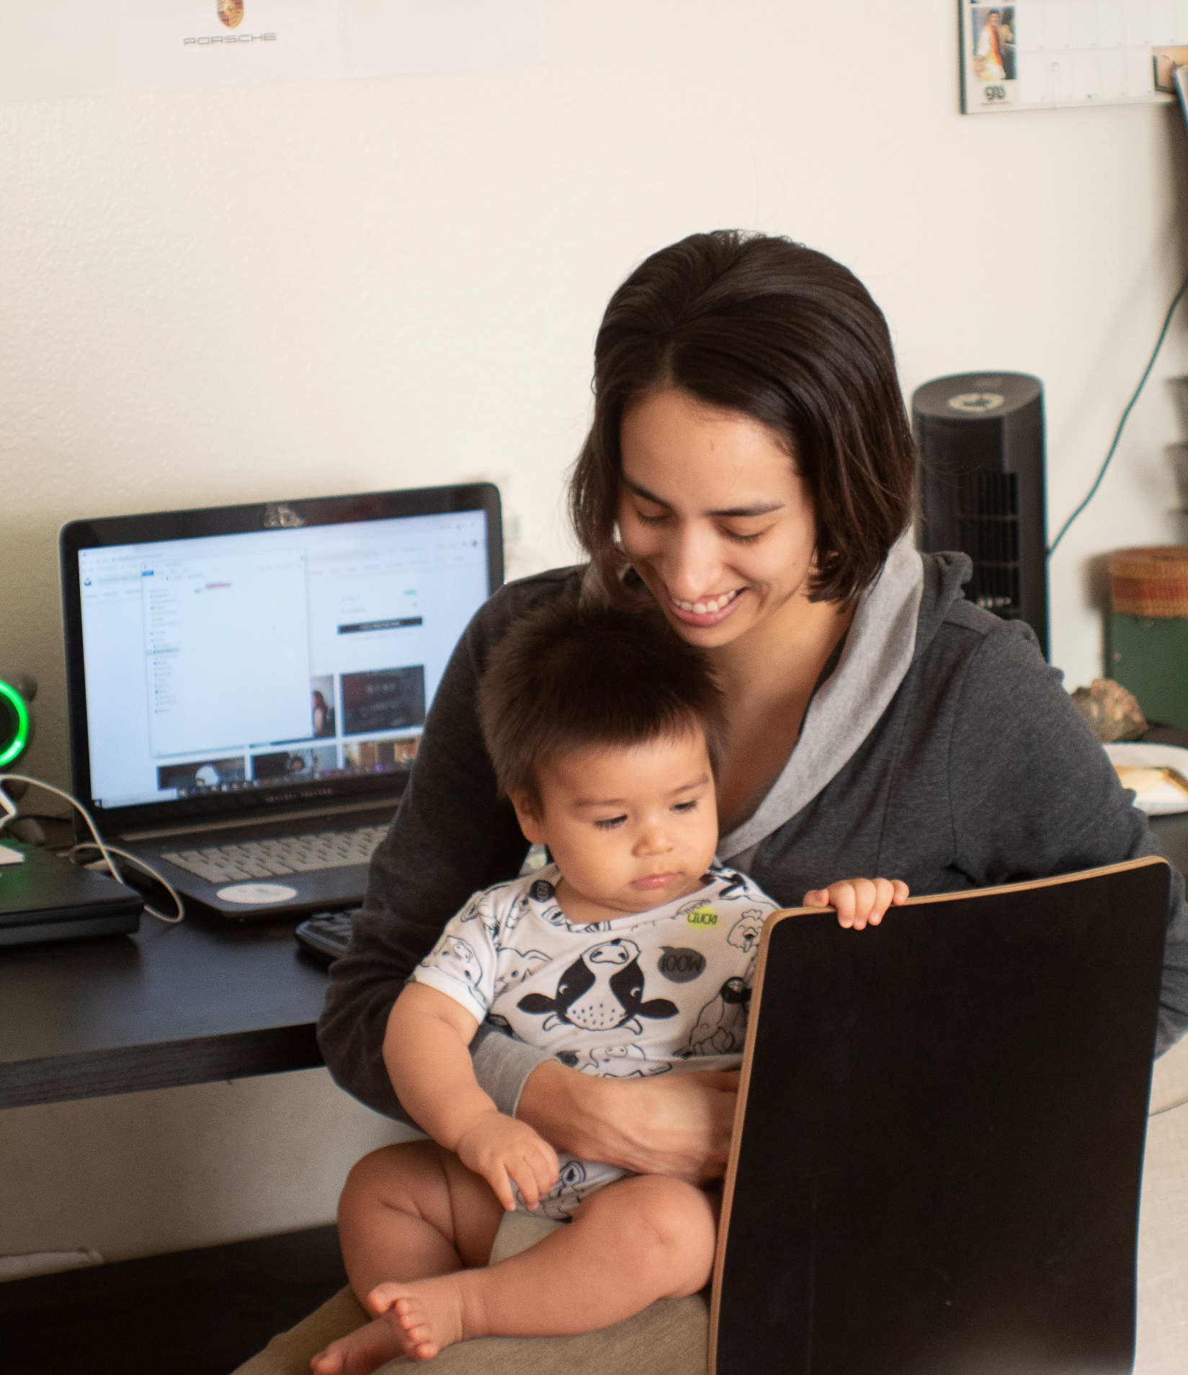

3
Why did you choose to learn web Development
Segmentation Issue
A good perk about web development is you can work from anywhere. The pandemic showed us how important it is to be flexible with your work hours.
Simply Put:
I got into web development because I was inspired but great entrepreneurs’ in the tech space like Mark Zuckerburg, Bill Gates, Elon Musk etc. that had hands on experience in the tools they created that had great impact on people’s lives and I wanted to do that.
Freelance Opportunities
If you’re the type that like working project to project on your own terms. Then becoming a freelance web developer is just right for you.

